Slide 1
Guidance from St Teresa of Avila on Spiritual Networking
Julienne McLean
Alumni meeting on Wednesday 28th May 2025

Slide 2
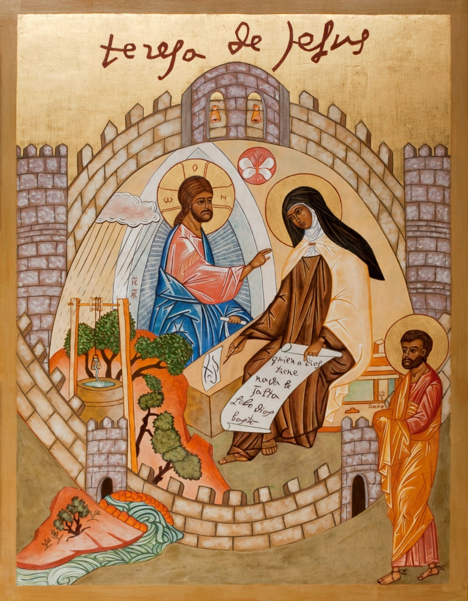

Slide 3
St Teresa can offer valuable insights into cultivating successful and authentic networking, both in our active, exterior life and our contemplative, interior life of prayer, towards union with Christ.
While her writings primarily focus of the inner journey of the soul and her experience of God, there are aspects of her teaching that can relate to the wisdom of networking and building relationships.
Her spiritual and psychological guidance, particularly in her Interior Castle, emphasizes the importance of deep connection, prayer, humility, spiritual companionship and genuine love, care, charity and giving to others, in our local and worldwide communities. This can be applied to any form of spiritual networking, community building and our life of action and contemplative prayer.

Slide 4
Some reflections from the writings, guidance and teaching from St Teresa related to networking
Cultivating deep connection – St Teresa’s powerful focus on prayer and spiritual growth and transformation, in Christ, emphasizes the importance of genuine connection with oneself, others and the world, in faith, hope, love and charity.
In both secular and spiritual networking, this translates to investing our time, love, resources and attention in building meaningful relationships, listening deeply and understanding the unique needs and perspectives of others.

Slide 5
Humility and Self Awareness – St Teresa’s journey of spiritual transformation involves a deep understanding of our own limitations, vulnerabilities and weaknesses, in humility, metanoia and self knowledge. In networking, sincere humility helps to avoid arrogance, pride and inflation and creates an environment of deep trust and openness.
Genuine Care and Compassion – St Teresa’s writings highlight the importance of loving one another and constantly practising charity. In networking, this translates to actively seeking to help and support others, offering genuine kindness and understanding.

Slide 6
Living a life of loving service and charity – St Teresa’s life was a testament to her commitment to serving her sisters, communities, the wider church and the world. In networking, this can manifest as proactively offering our skills, gifts, talents, concern and resources to others, with genuine love, selflessness, graciousness and kindness.

Slide 7
Perseverance and overcoming Adversity – St Teresa faced numerous challenges and setbacks in her pursuit of spiritual growth and the Carmelite reform. The Book of Her Foundations is a fascinating testament to the founding of fifteen of her new discalced Carmelite communities.
In networking, patience and perseverance, and cultivating spiritual companionship, is vital in overcoming obstacles, being able to stay loyal, steadfast and trusting in building relationships, as well as maintaining a humble, prayerful attitude, even when faced with adversity, difficulties and struggles.

Slide 8
By following St Teresa’s principles of deep connection, humility, genuine care and love, we can cultivate a thriving network in our lives that deeply fosters personal growth, strengthens relationships and contributes to a more positive and supportive community.

Slide 9
Building strong relationships and networking
Community and collaboration – St Teresa was a visionary who understood the power of community, founding many convents and actively working to reform the Carmelite order, emphasizing the importance of building strong relationships with her sisters and God.
Compassion and empathy – St Teresa’s writings are filled with many descriptions of her passionate love for Jesus and all her fellow human beings, emphasizing the importance of compassion, empathy and understanding in constantly building meaningful relationships and community.

Slide 10
Active listening and communication – St Teresa’s life demonstrates the importance of active listening and communication in building strong relationships. She actively sought to understand the needs of others and to communicate her own experiences and insights in a way that was accessible, helpful and relatable to others.
Cultivating shared interests – St Teresa found fulfilment in connecting with others who shared her passion for prayer, Carmelite spirituality and the pursuit of holiness.

Slide 11
The Power of Prayer and contemplation
Abiding in God as our true foundation - St Teresa believed that the journey of contemplative prayer, towards union with Christ in the centre of our soul, is the true foundation of our life, alongside the outflow of our love, good works, and active charity to the world. She describes this as the balance of ‘Mary and Martha’ in our life, especially in the seventh dwelling place of the Interior Castle.
Finding peace and inner strength, in God – St Teresa’s experiences in prayer and contemplation helped her surrender to, and be transformed by, the Love and Presence of Christ throughout in her life, which enabled her to live and express deep faith, hope, love and charity in her foundations, the wider church and throughout the world.

Slide 12
Drawing on Divine Guidance – St Teresa actively sought divine guidance and inspiration, from Christ and the Holy Spirit, as well as several holy fathers, such as St John of the Cross and St Peter of Alcantara, both in prayer and in all her decisions and actions, which are beautifully recorded in her writings.

Slide 13
Questions for reflection –
What are your own particular gifts of networking? What areas may need further growth, openness and reflection in your life?
What is the balance of the active and contemplative dimensions of your life, of ‘Mary and Martha’, at present?

