Slide 1


With
The Centre for Applied Carmelite Spirituality
An introduction to trauma informed care in ministry
How do we respond and support those with a background of trauma?

Slide 2
Agreeing together
Many of us carry trauma – respect each other
Listen to your nervous system
What do you need? - safety and choice
A reminder about confidentiality

Slide 3
We hope you will come away from this workshop
With raised awareness of individual signs of trauma responses
Able to name ways trauma can affect people’s experience of the Christian faith and church activities.
Aware of the importance of understanding attachment theory in interpreting behaviours
Able to name ways to be more accessible to people who have experienced adversity.
Able to discuss the importance of preventing traumatisation in the first place.
Notes:
RUTH

Slide 4
On a scale of 0-5 Please rate your current knowledge
5 means that I am very familiar with this, 1 means I have no knowledge
Before
1.How confident do you feel in your knowledge of trauma?
1
2
3
4
5
2. How confident do you feel in supporting individuals who have been through
trauma?
1
2
3
4
5
Notes:
RUTH

Slide 5
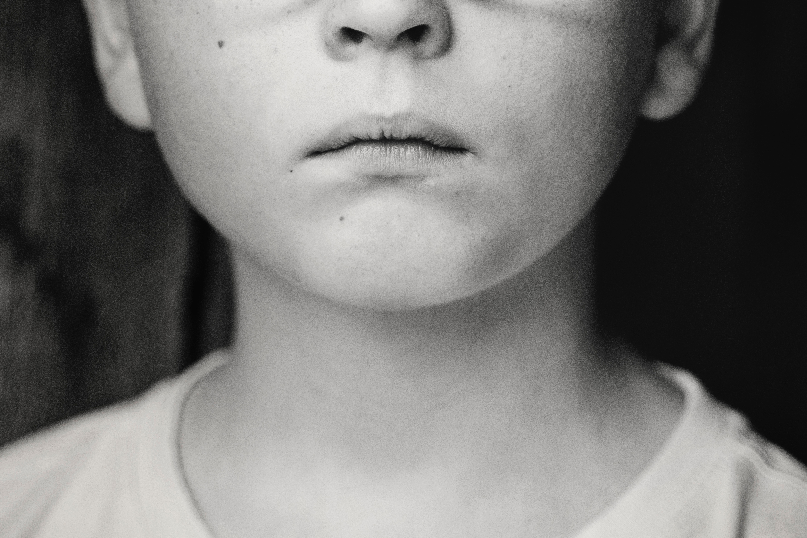

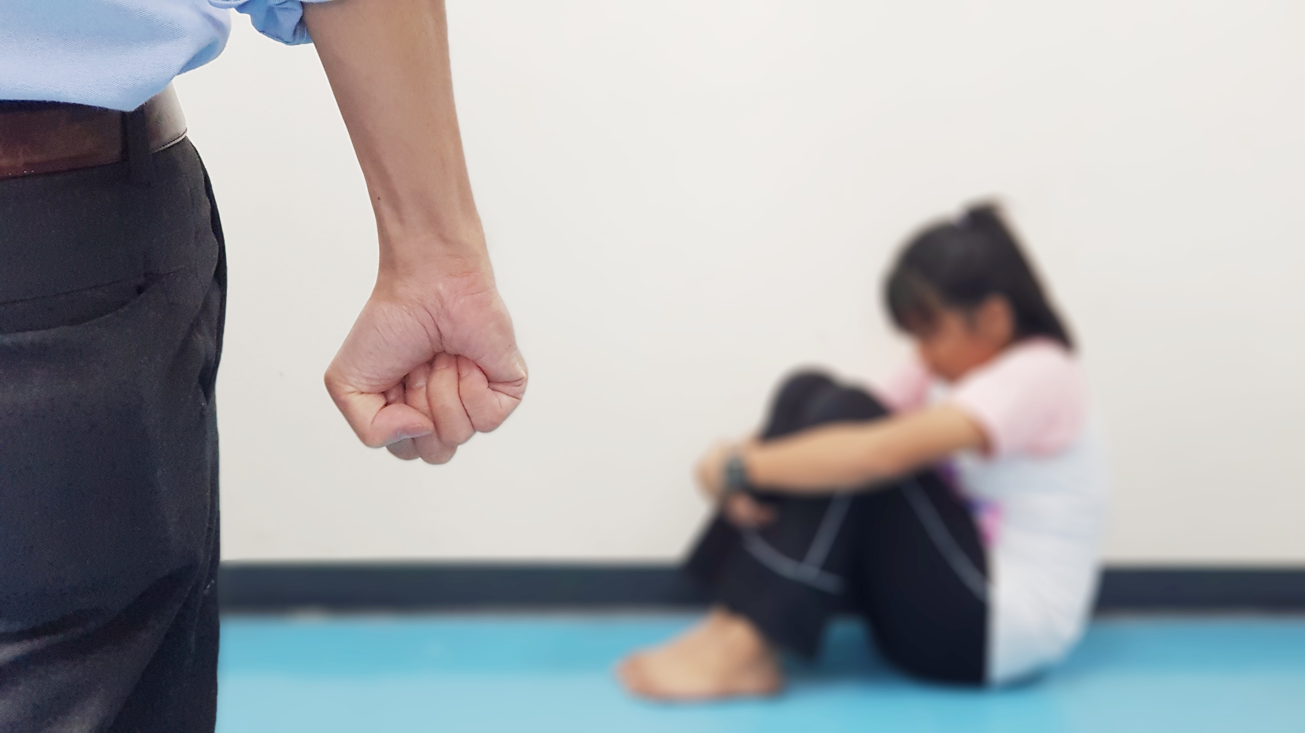
What is trauma?
“Trauma results from an event, series of events, or circumstances that are experienced by the individual as physically or emotionally harmful or threatening, and that have lasting adverse effects on an individual's functioning and (physical, emotional and spiritual) well-being”
From SAMHSA
Substance abuse and mental health services administration

Slide 6
Chronic or complex trauma: multiple and prolonged exposure
Inter-generational trauma
One off shock trauma
Collective
trauma
Developmental trauma
Vicarious
trauma
Notes:
Complex trauma is THE EXPERIENCE OF MULTIPLE, CHRONIC, AND PROLONGED DEVELOPMENTALLY ADVERSE TRAUMATIC EVENTS, MOST OFTEN OF AN INTERPERSONAL NATURE. (Bessel Van Der Kolk)

Slide 7
Statistics
47 % experienced one ACE
14% Experienced 4 or more ACES
ACES study Wales 2015
ACES, Chronic disease and health service use in Wales
Notes:
TRACY

Slide 8
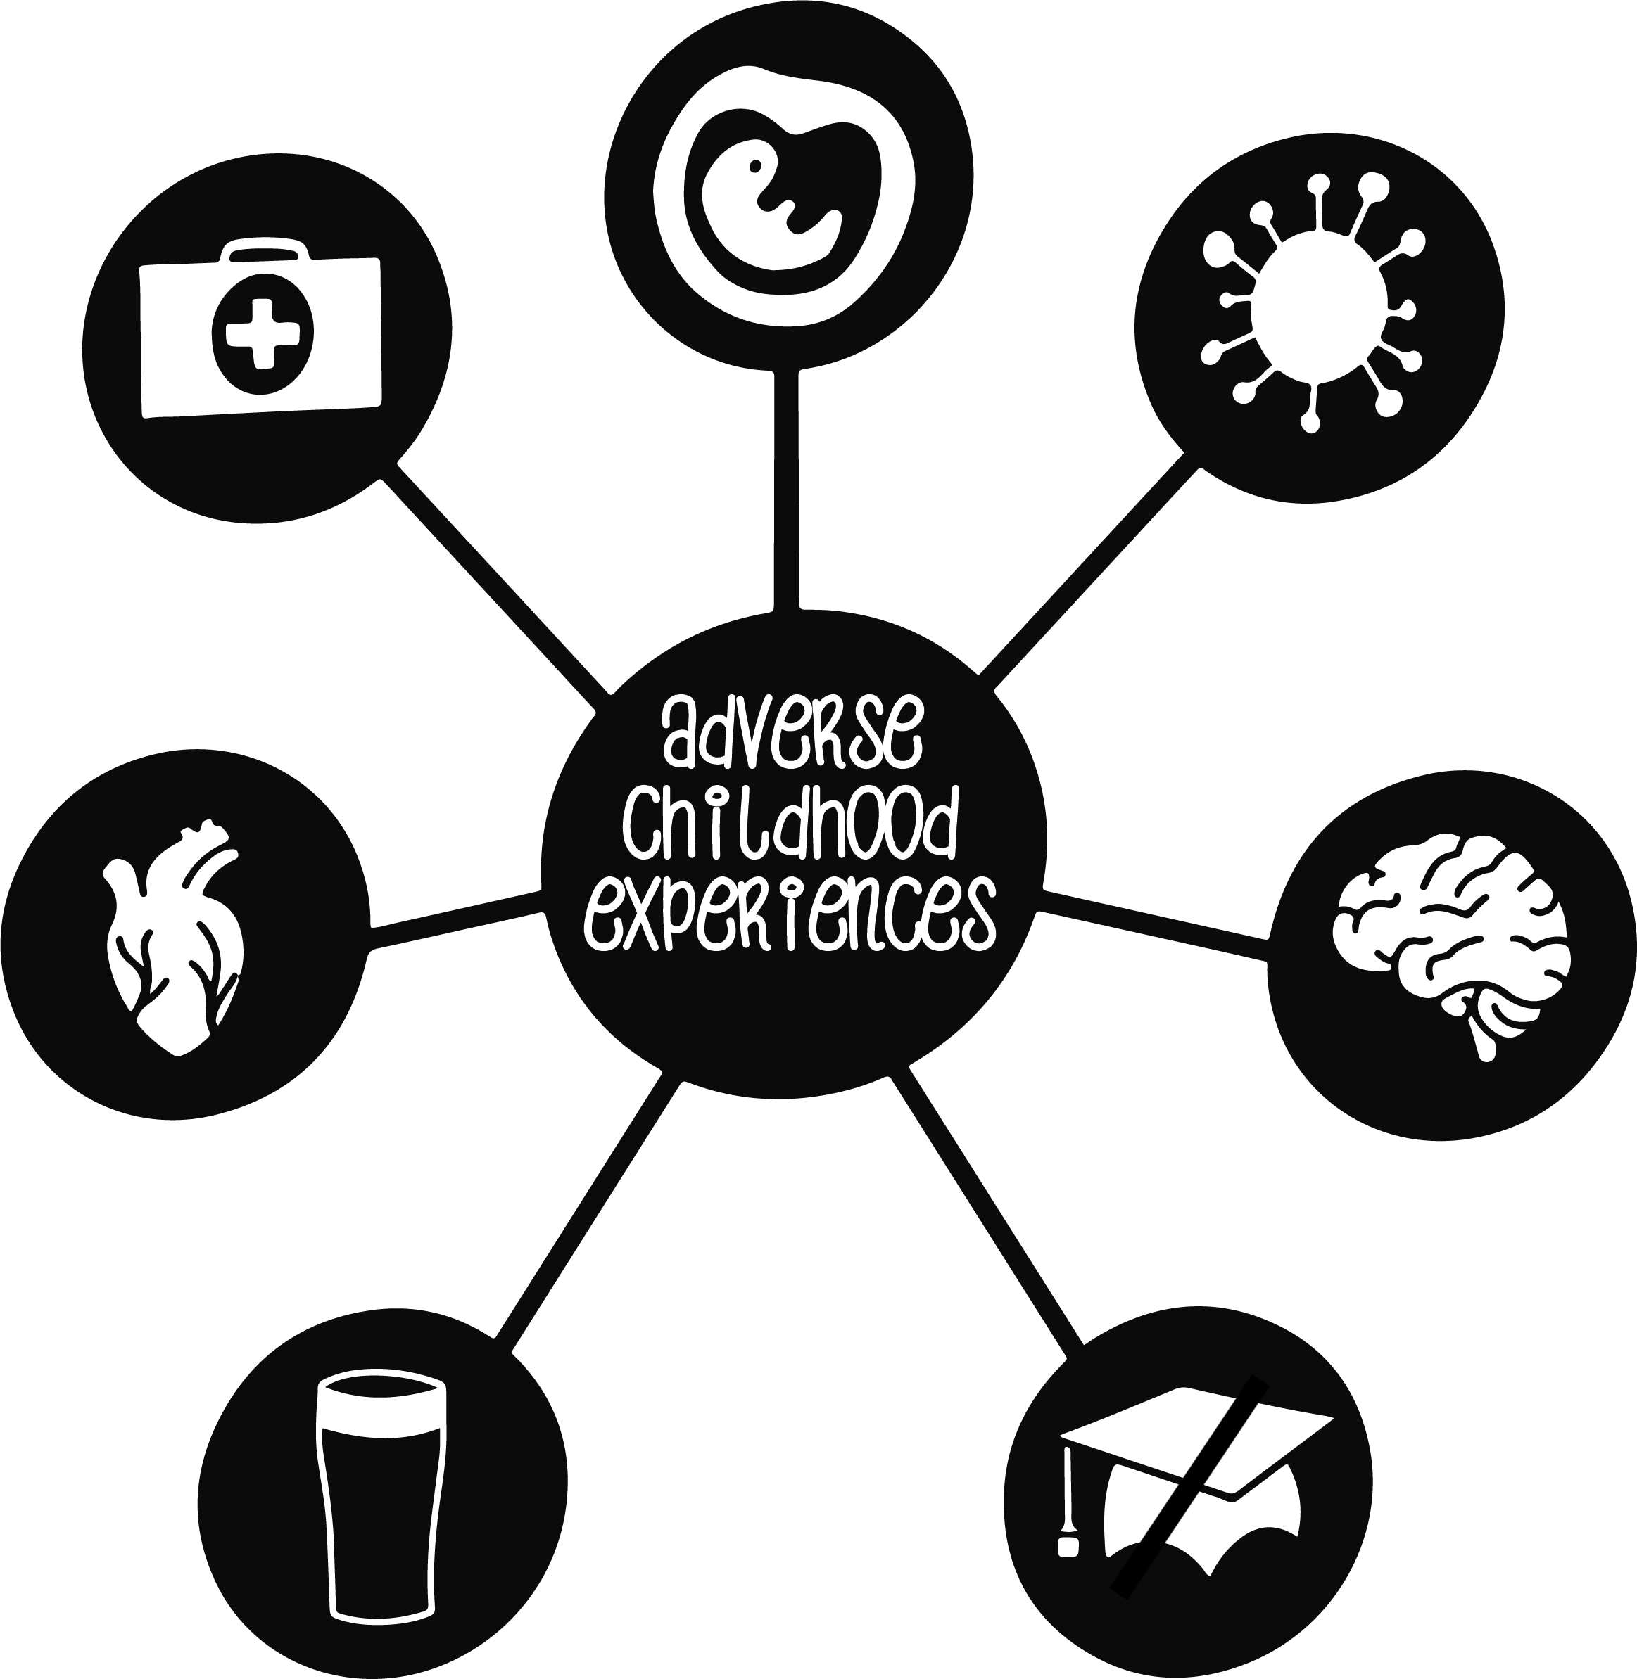
Are our services trauma reducing or trauma inducing?

Slide 9
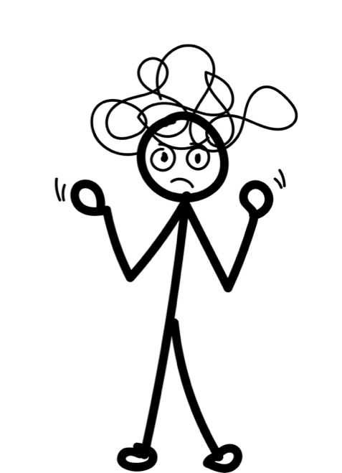
The body remembers

Slide 10

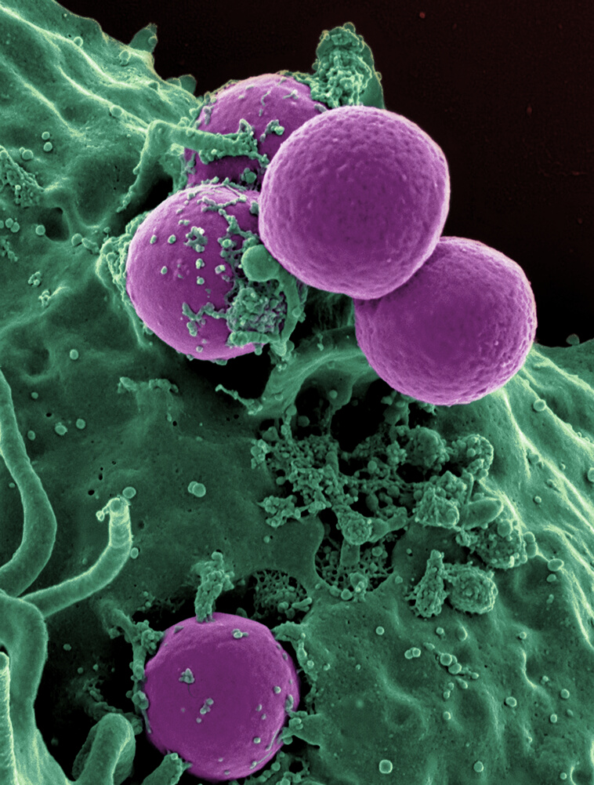
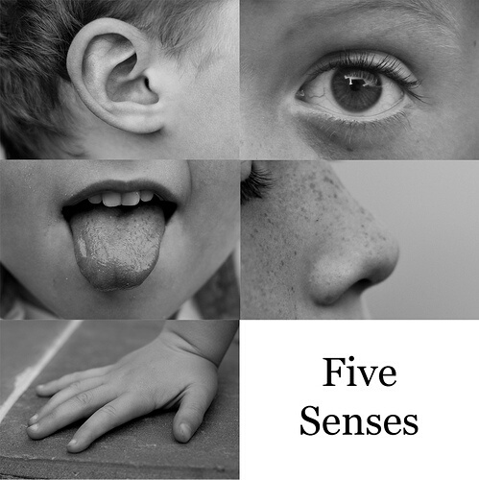
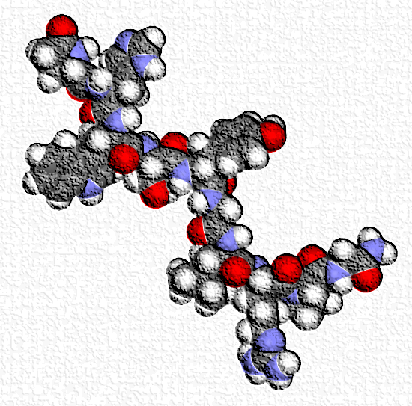
Early trauma is deeply somatic
The nervous system
The immune system
Toxic stress also affects our DNA
The Sensory systems
The endocrine system
Notes:
RUTH

Slide 11
The hand model of the brain
“People who have been through trauma experience the world through a different nervous system”
Bessel Van der Kolk
Notes:
Hand model of the brain.

Slide 12
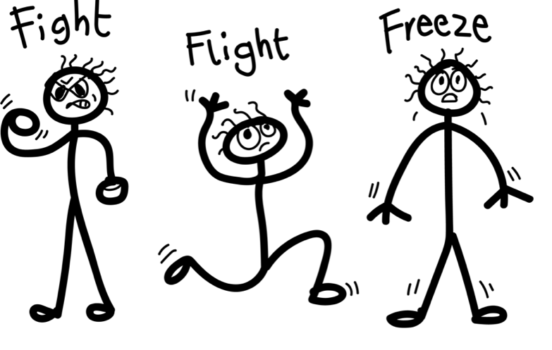
If the fear responses are active, we won't be able to engage properly with what is happening around us

Slide 13
Shouting
Blaming
Kicking
Aggressive
Defiant
Creating conflict
Disrespectful
Fight:
Fear
responses
Flat mood
Foggy
Retreating
Moving slowly
Avoiding conflict
Dissociates
Freeze:
Flee
Agitated
Anxious
Hiding
Sneaky about creating conflict
Flight:
Notes:
RUTH

Slide 14
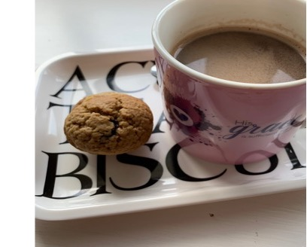
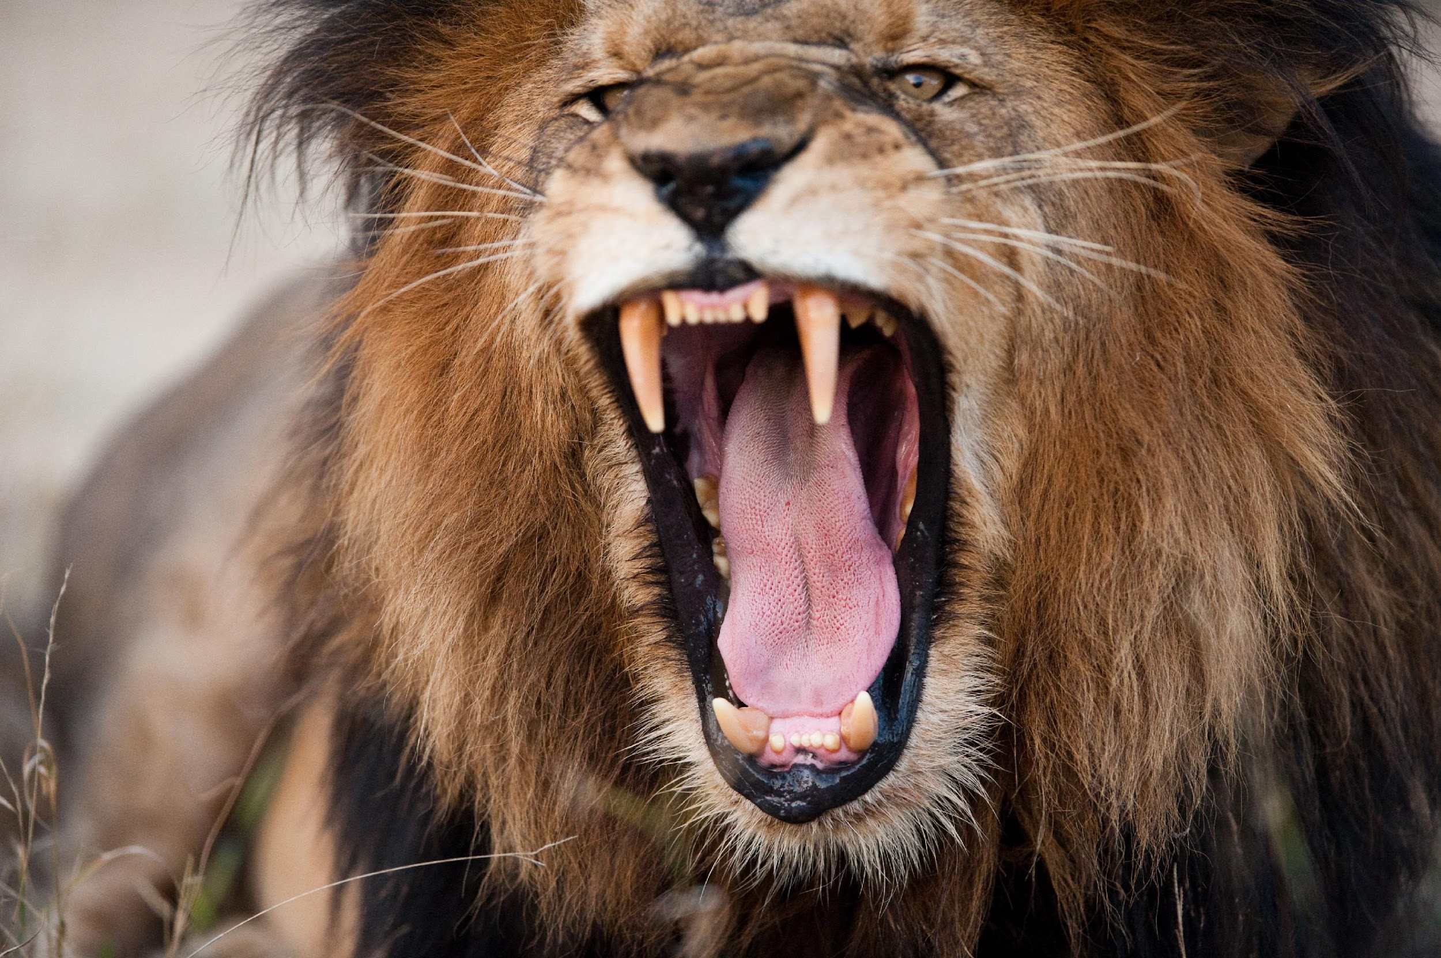
Trauma is trapped in the sub-conscious
Cues of safety
Cues of danger
Notes:
It literally affects every part of the nervous system.
Is the sensation safe or scary?

Slide 15
How trauma can present
Regulation
and
arousal
Brain
development,
function and
response
Relationships
Attachment and social interaction
Cognitive and executive functioning
Over - compliant
Behaviour
Coordination
difficulties
sensory
issues
Emotional world
Mood
changes

Slide 16
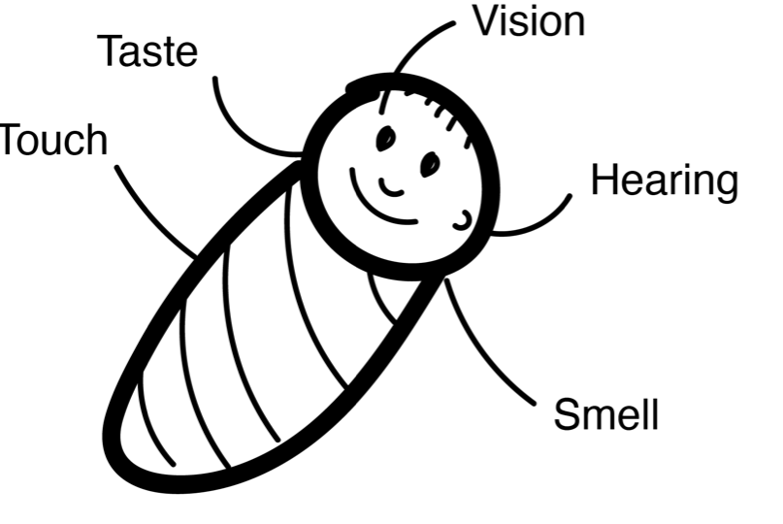
Early sensory development
Babies don’t have language
So all of their memories are sensory memories
Notes:
What sensory experiences does a baby have?
How might these go wrong?
What might happen if they do?

Slide 17
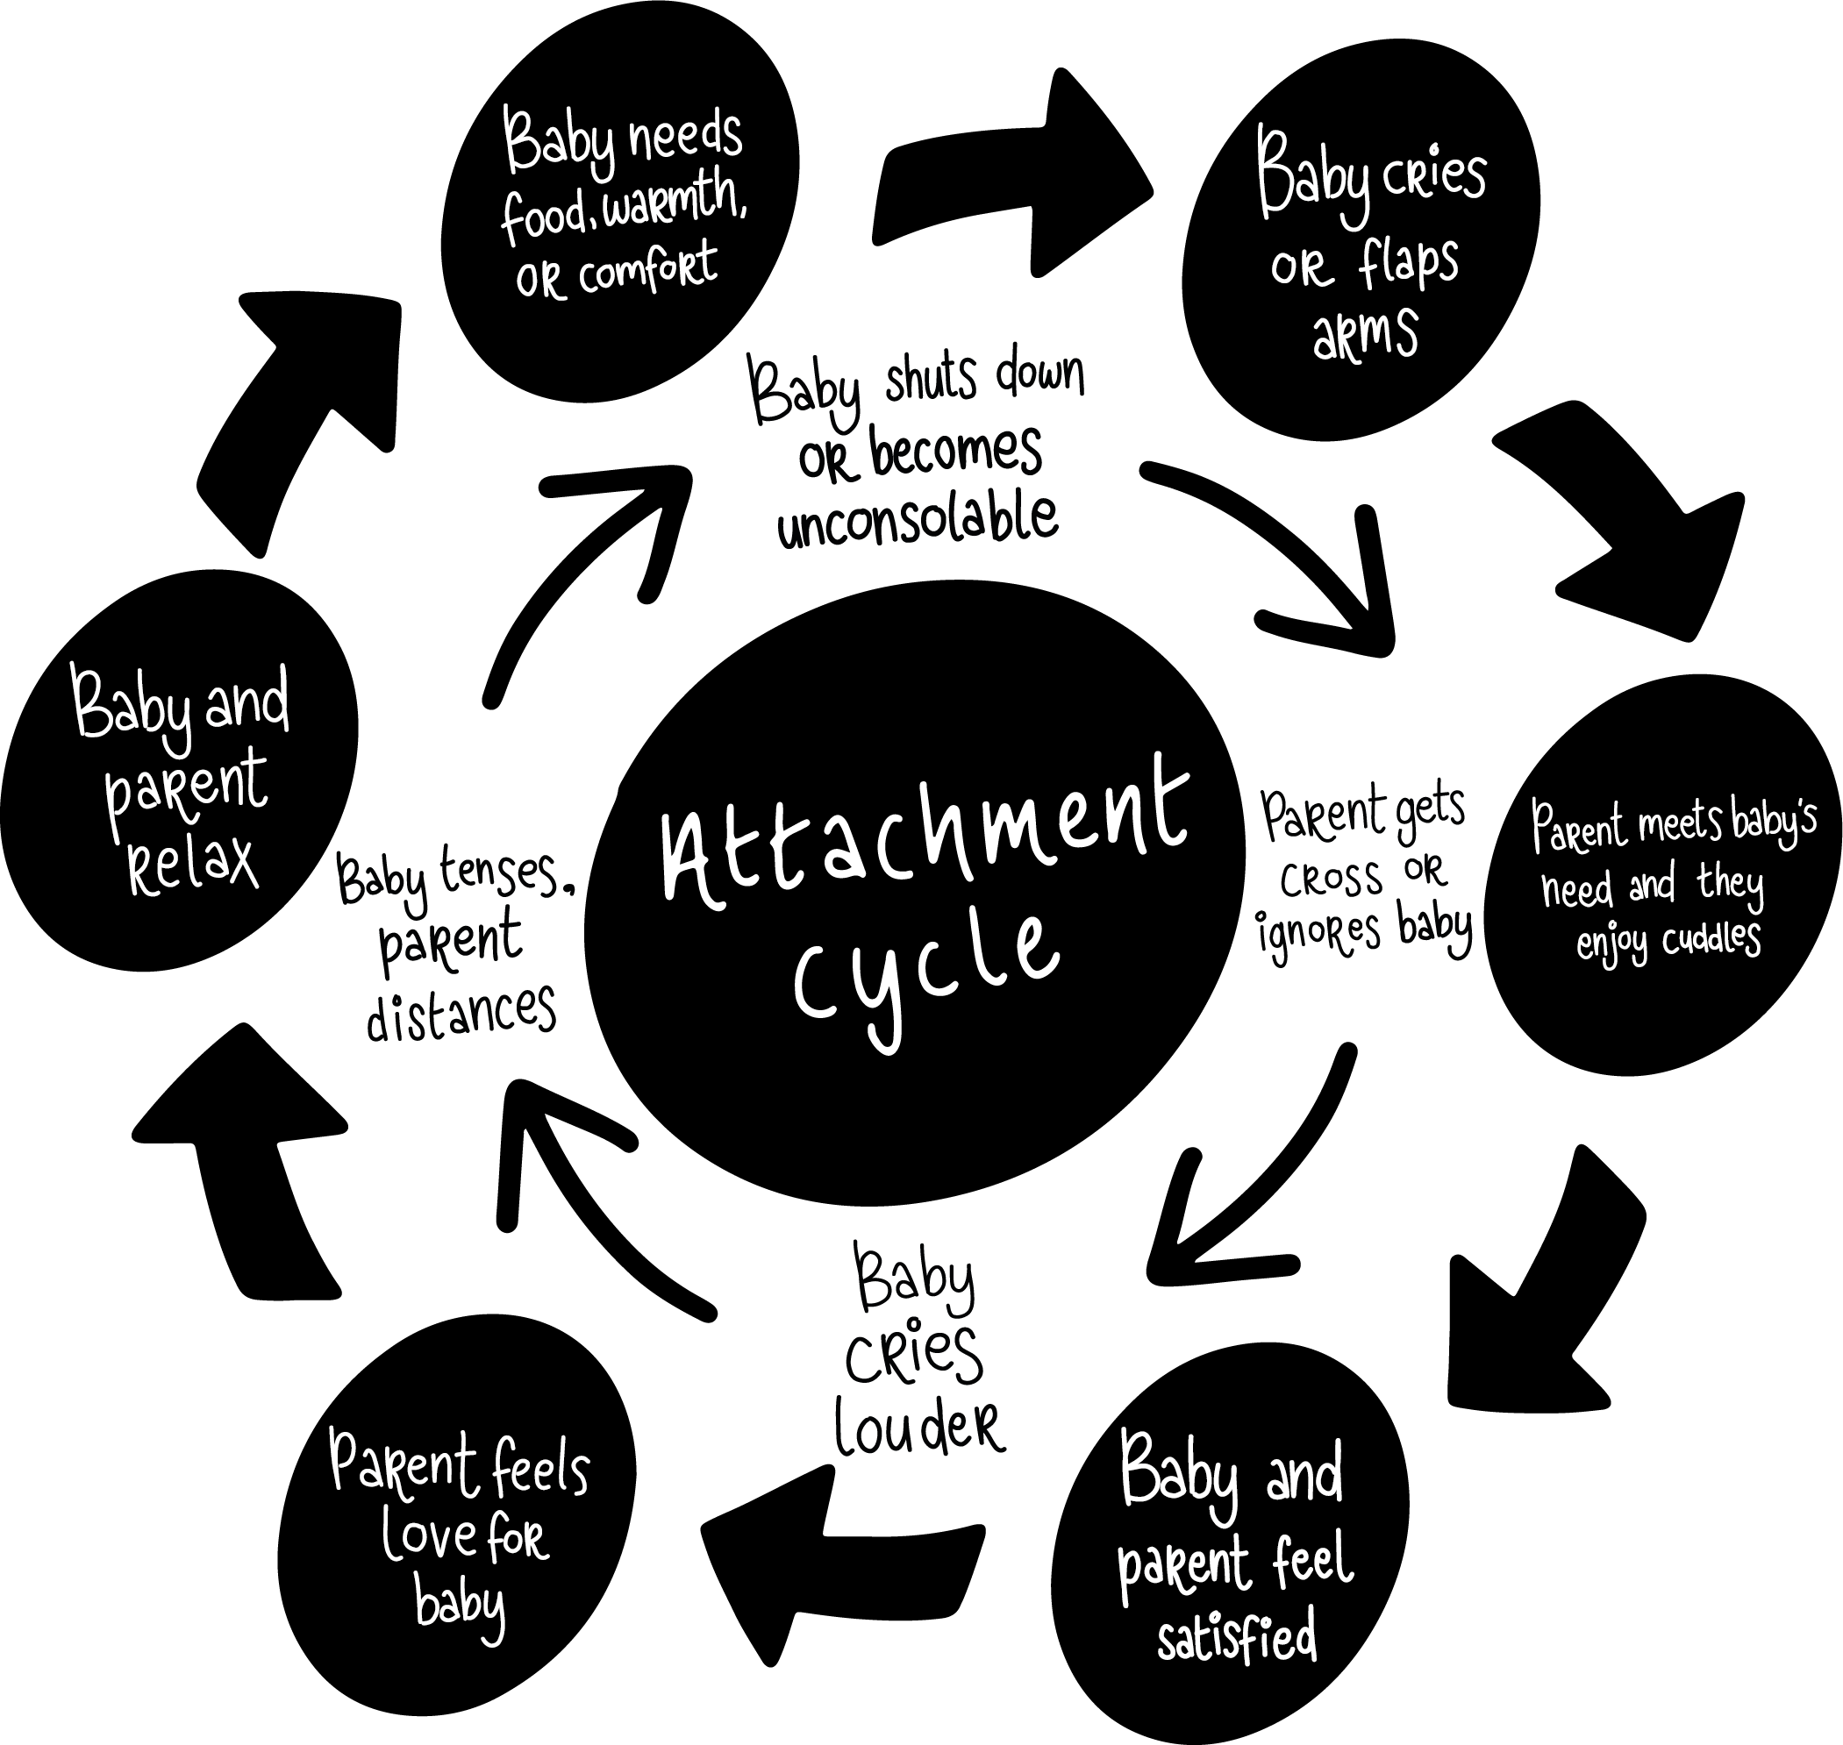
The Attachment Cycle
Attachment is fundamental to understanding how people tick

Slide 18
Behaviour = communication
Think attachment seeking – not attention seeking

Slide 19
What we see on the surface might not reflect what is going on underneath
Presenting behaviours
Actual feelings
Notes:
Check in with your peers. Notice what is going on. Be there for each other.

Slide 20
What are you seeing?
What are you hearing?
What else do you notice?
What might be going on under the surface?
What emotions might they feel?
What thoughts might they be having?

Slide 21
The marks of a trauma sensitive culture:
Realises the widespread impact of trauma and understands the potential paths for recovery
Recognises the signs and symptoms of trauma in those we are involved with
Responds by fully integrating knowledge about trauma into policies, procedures and practices
Seeks to actively resist re-traumatisation.
Reference: https://www.samhsa.gov/
From SAMHSA

Slide 22

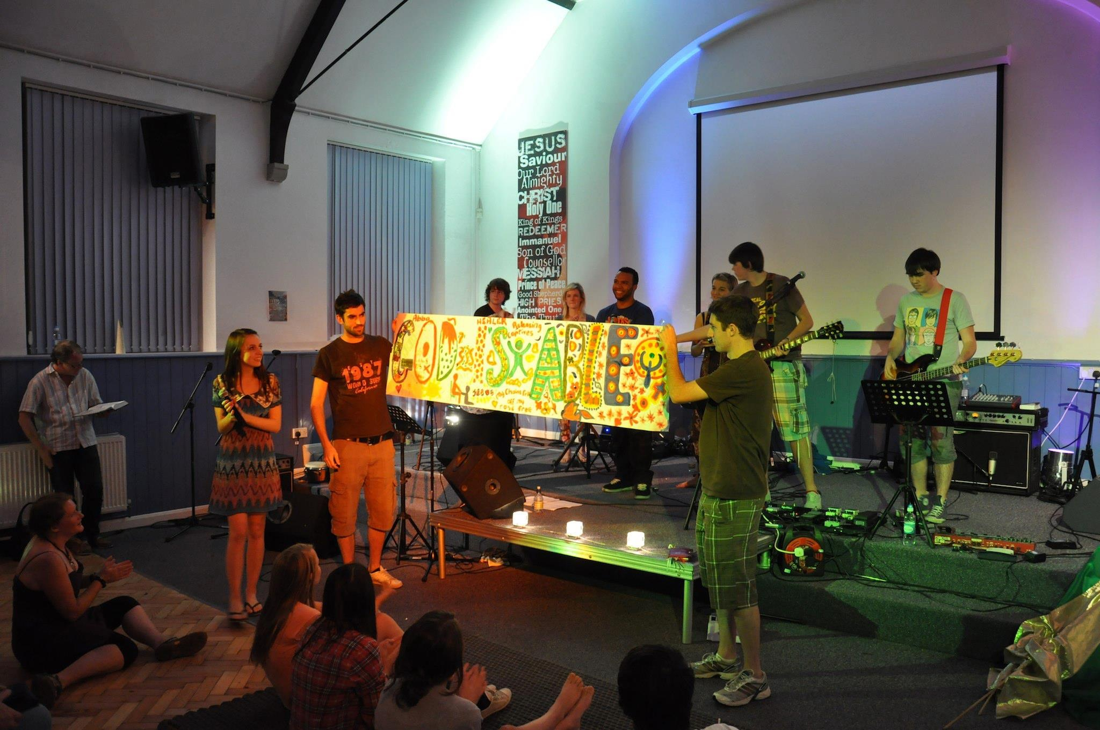


Create safety in 4 areas:
Relationships
Environment
Activities
Systems

Slide 23
“Every interaction is an intervention”
Dr Karen Treisman
Notes:
Are you thinking about what others are going through?
Maybe you look at those who are most impacted and imagine that it must be much worse than how you feel. We can all too easily look at what others go through and undermine our own experiences.

Slide 24
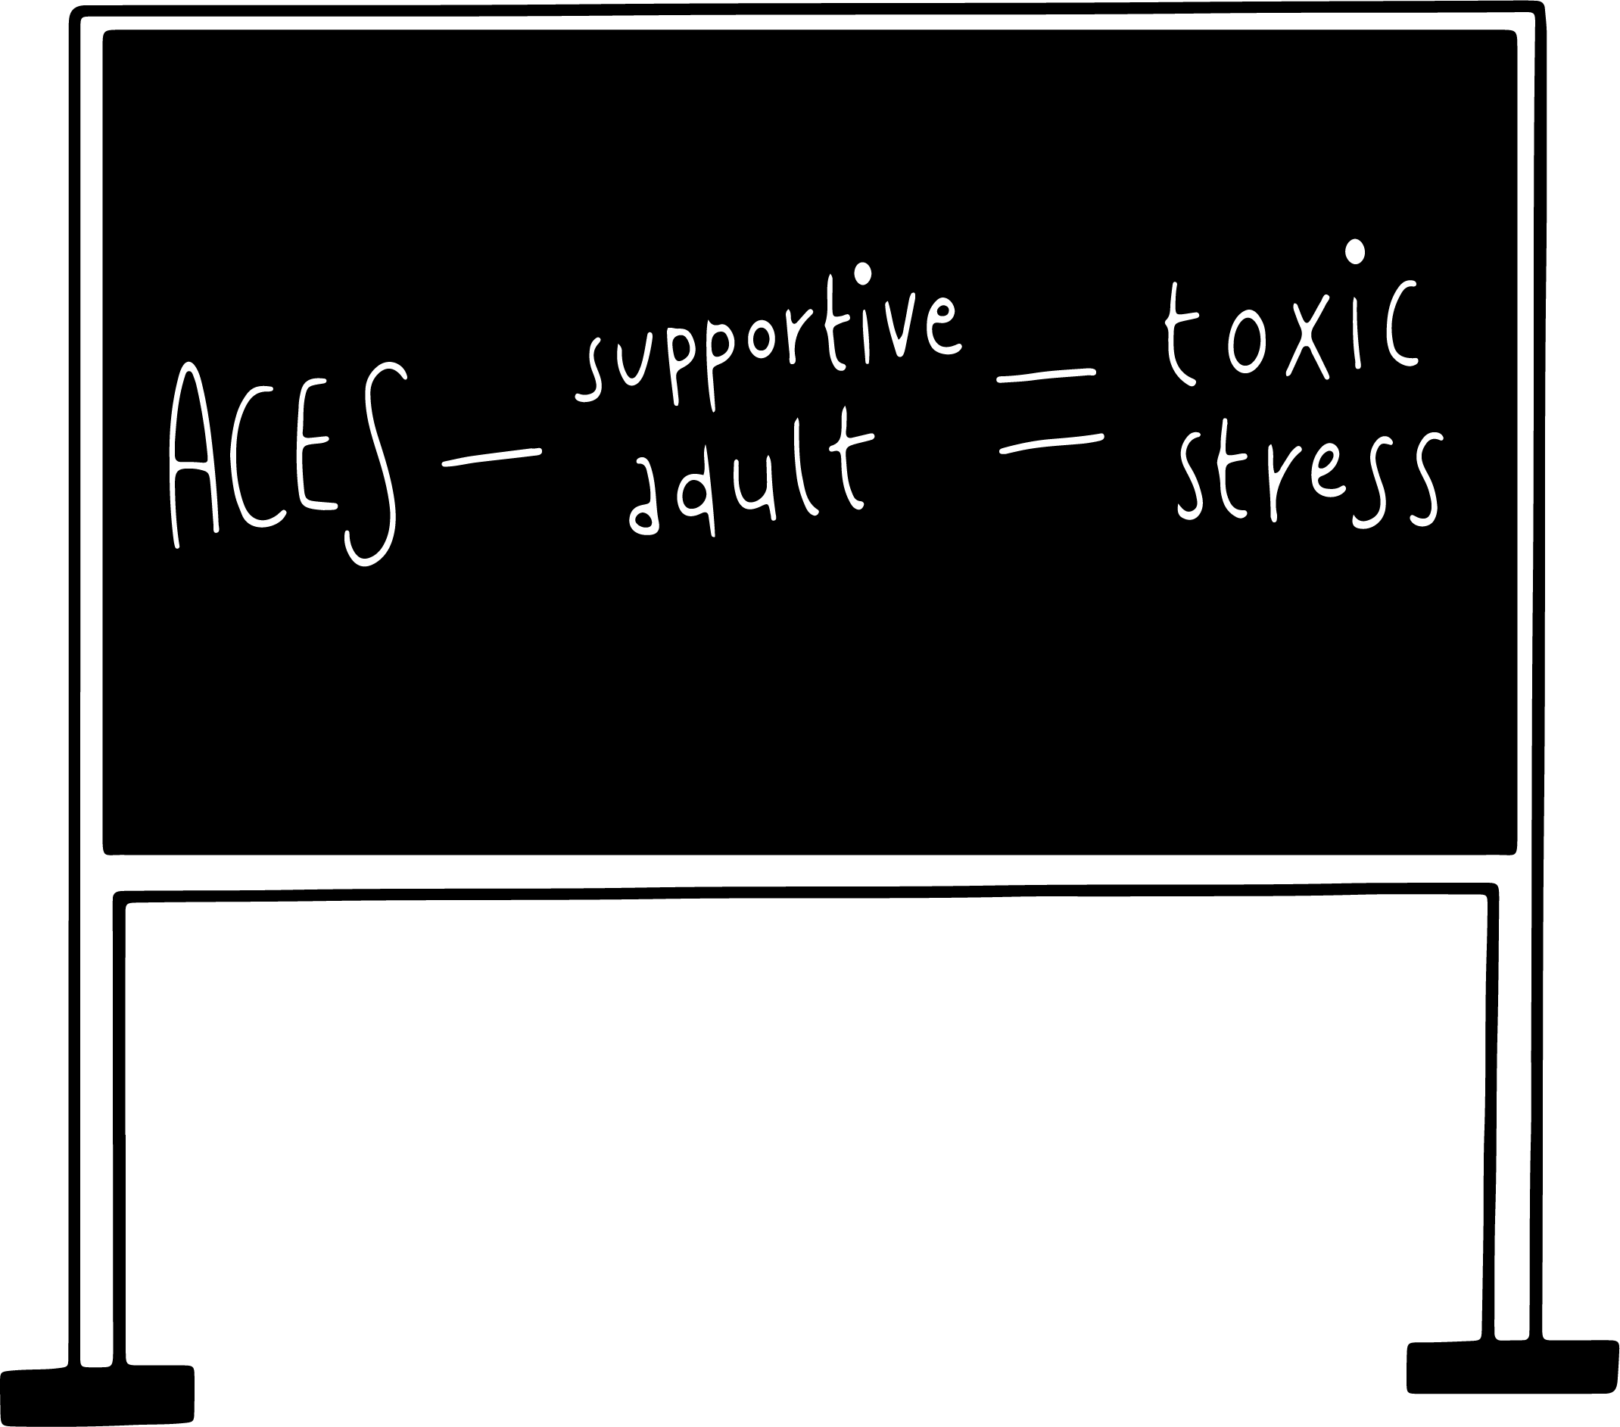
Relationships
Notes:
TRACY

Slide 25
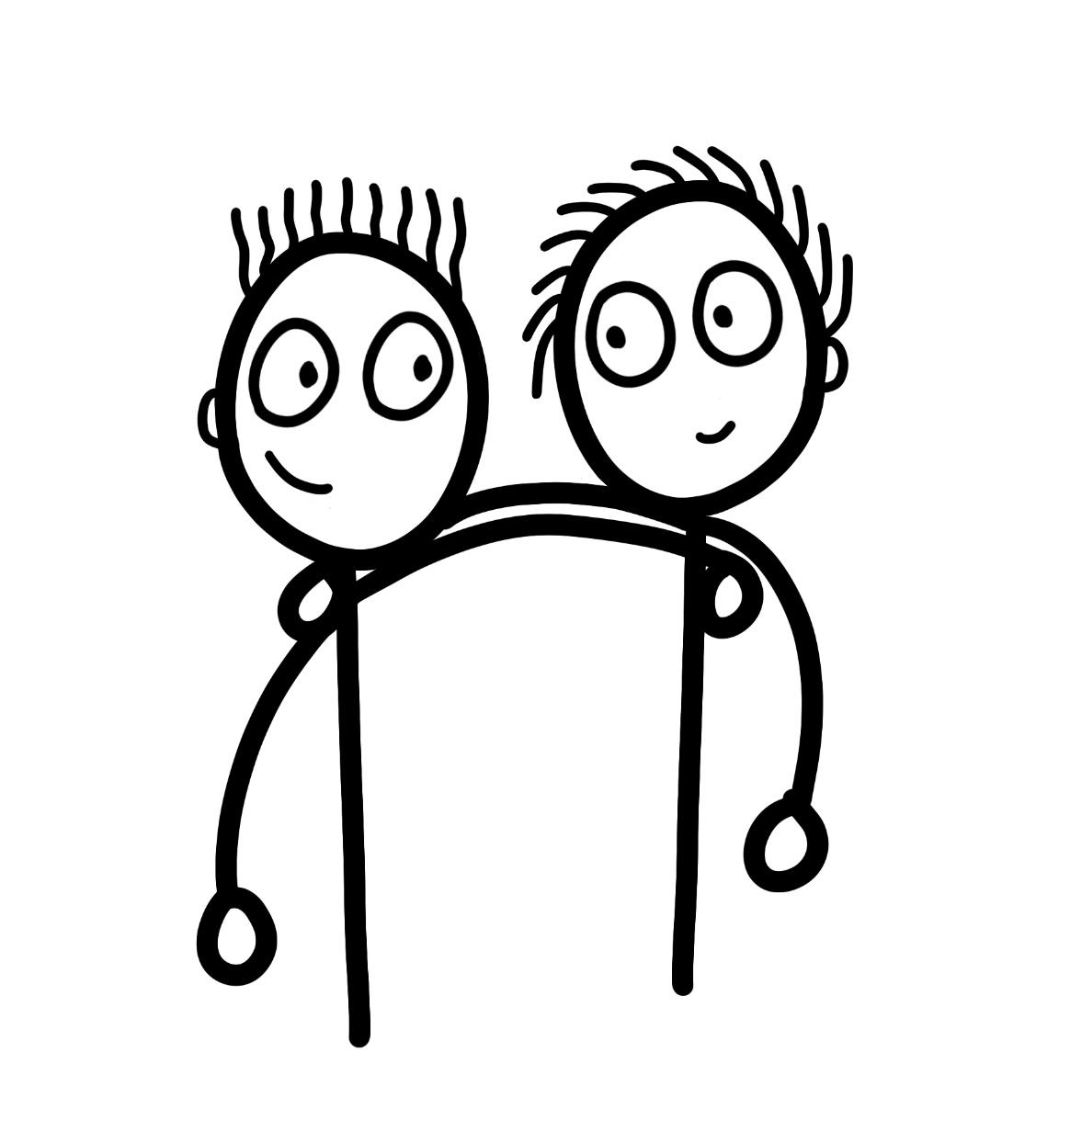
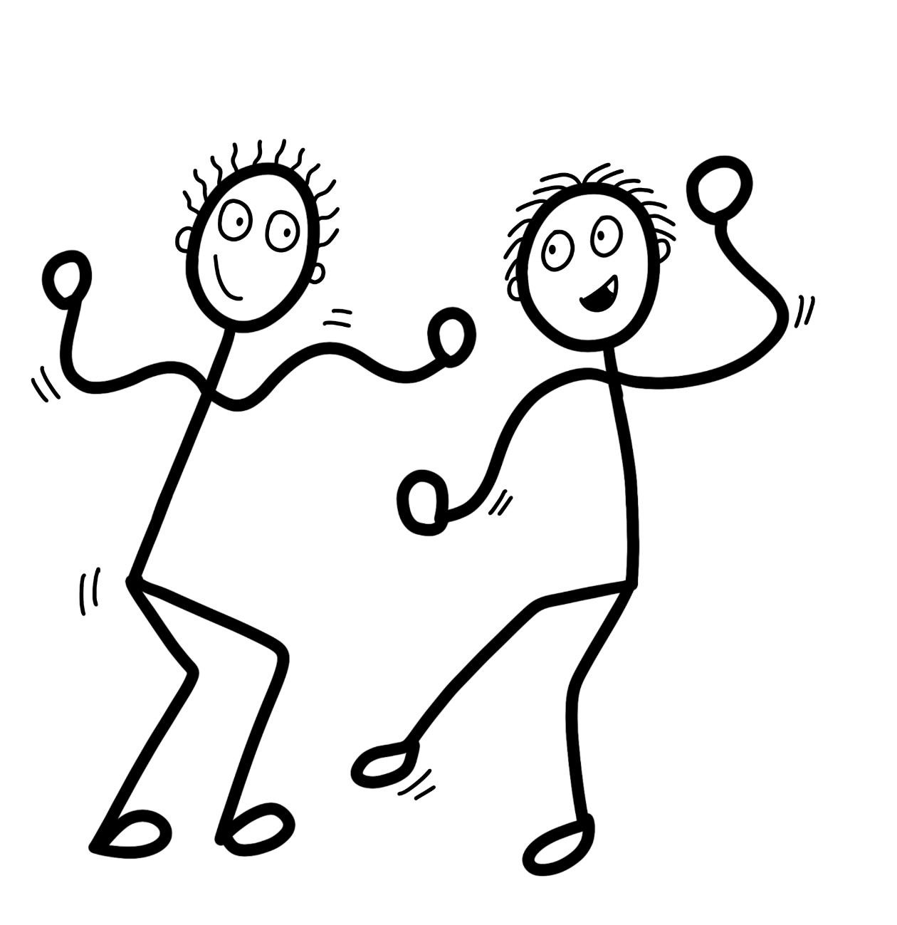


Playfulness
Acceptance
PACE
Curiosity
Empathy
Ref
Dan Hughs

Slide 26
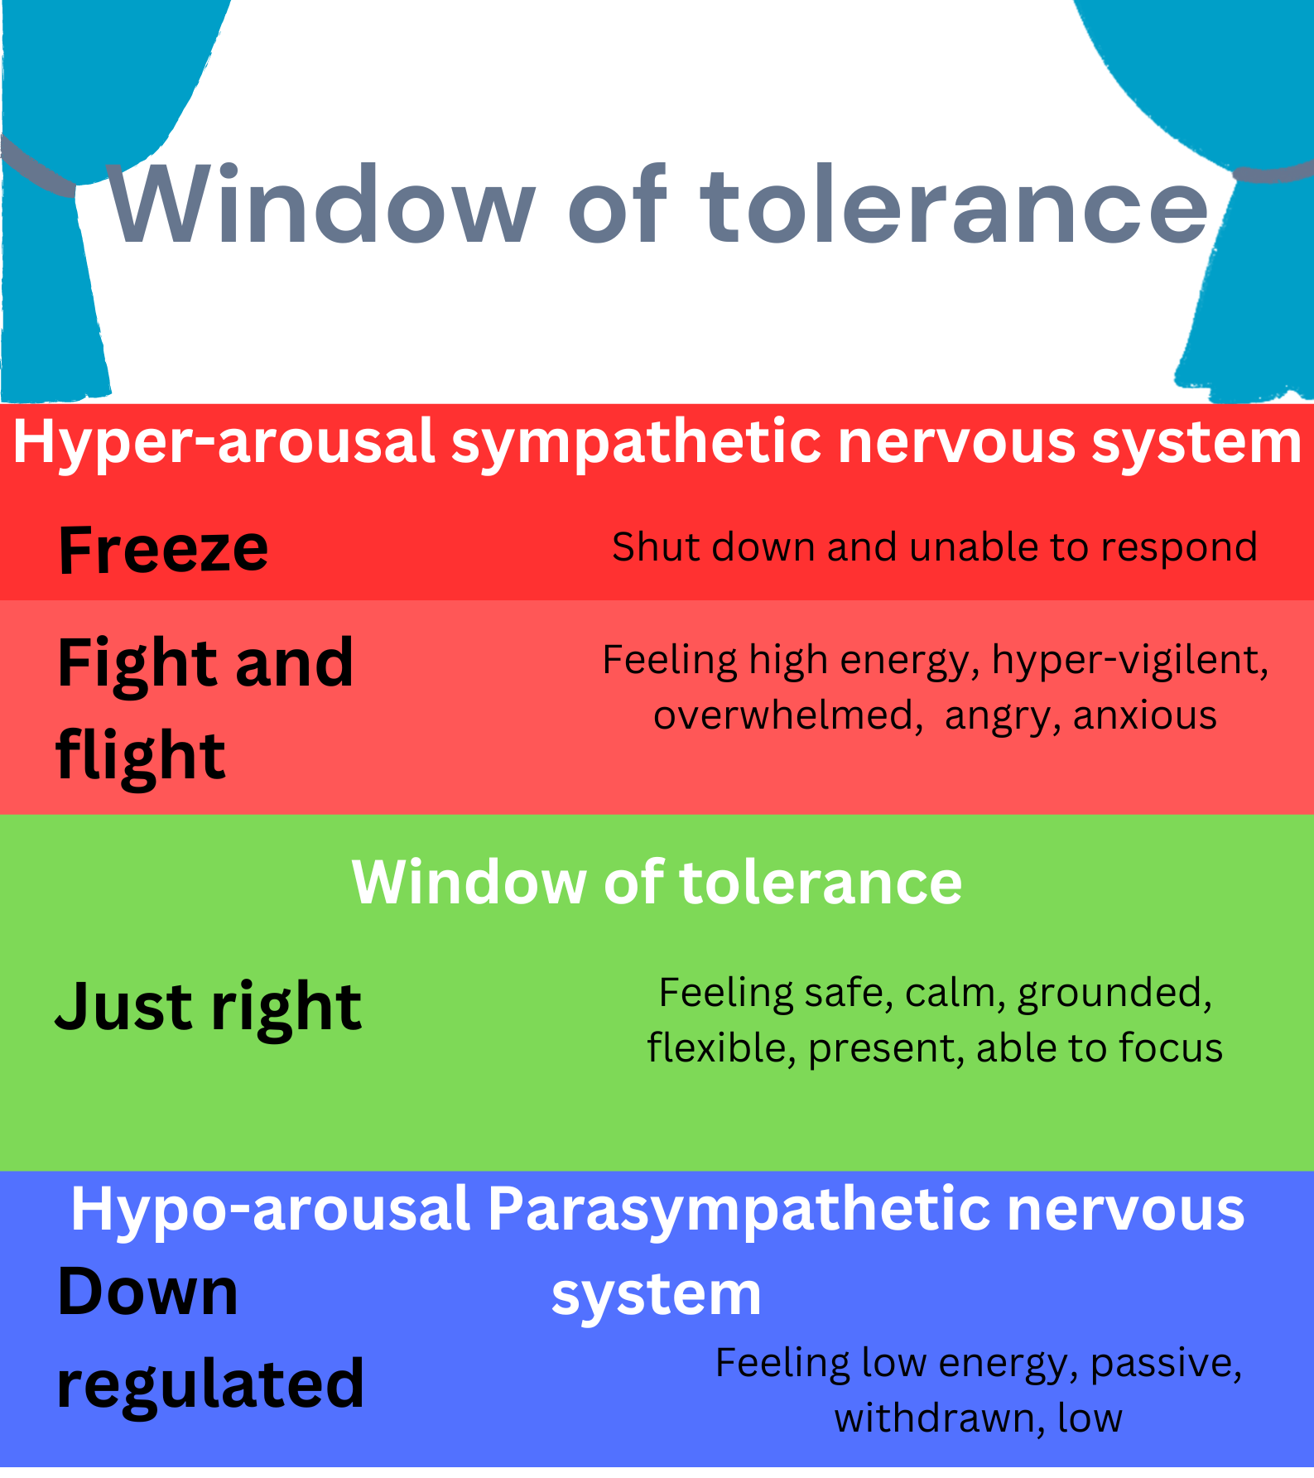
Where is your nervous system at?
Notes:
The window of tolerance is where we are at our personal best.

Slide 27

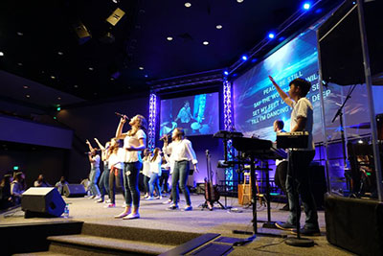
Environment
Colours and lights
Smells
Notes:
Think about breathing exercises- singing, finger breathing, Square breathing.
Rhythmical exercises
Movement

Slide 28
Activities
What do we offer that is actively supportive?
In our services how much opportunity for space and reflection for those who may be outside their window of tolerance?
Sitting listening for long periods
Is touch considered in welcome team, prayer ministry
Try to be Interactive
Children’s church– children who need movement – important to break up the programme.
Need to think about having space to be active

Slide 29
Steps to engaging in church
Learning Bible truths
Experiencing God's love & power
Building relationships
Grounding the nervous system: Are they feeling safe?
Notes:
RUTH

Slide 30
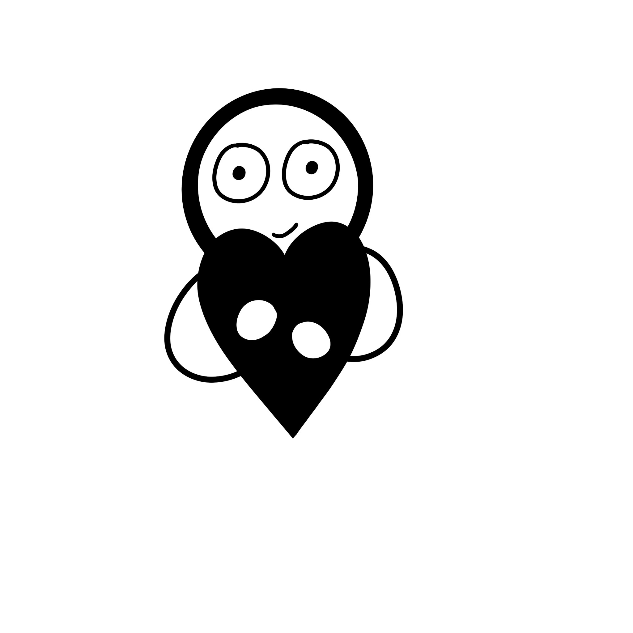
Be Self-aware
We can’t regulate someone else if we are not regulated
Self compassion is needed

Slide 31
What did Jesus do?
The woman who anoints Jesus’ feet
Luke 7: 36-39
Zacchaeus
Luke 19: 1-9
Notes:
maybe group discussion time

Slide 32

Challenges of culture shaping

Slide 33
On a scale of 0-5 Please rate your current knowledge
5 means that I am very familiar with this, 1 means I have no knowledge
After
1.How confident do you feel in your knowledge of trauma?
1
2
3
4
5
2. How confident do you feel in how to work with individuals who have been through
trauma?
1
2
3
4
5
Notes:
RUTH

Slide 34
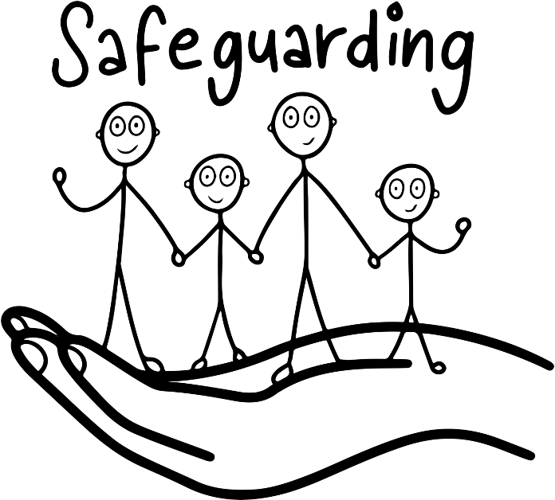



Always work with ROBUST SAFEGUARDING policies and procedures

Slide 35
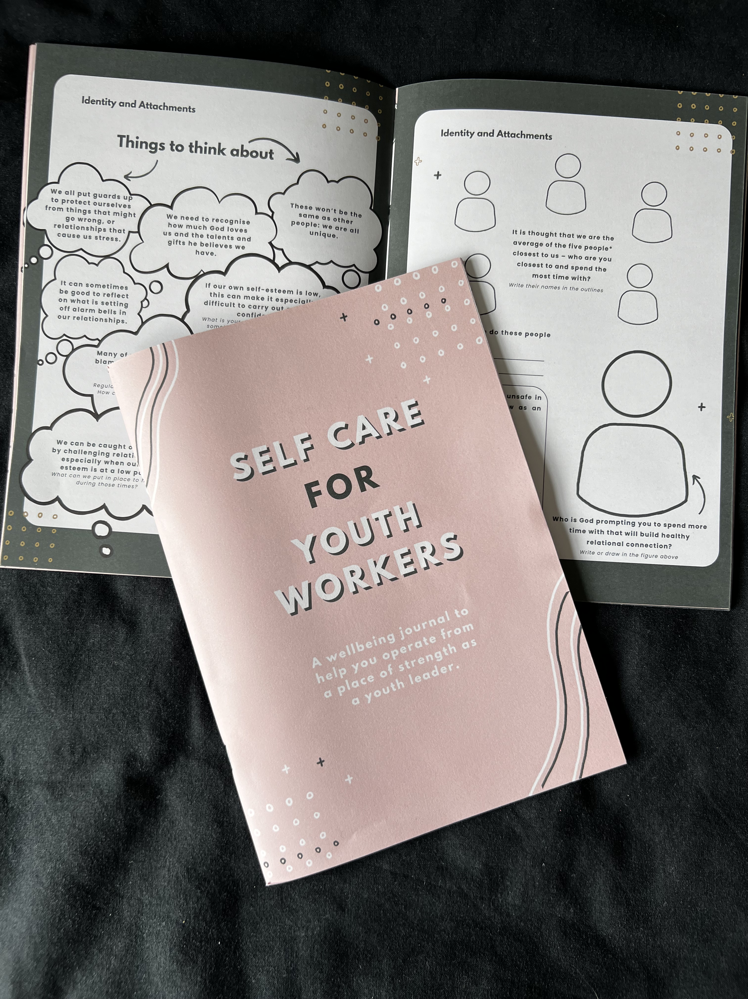
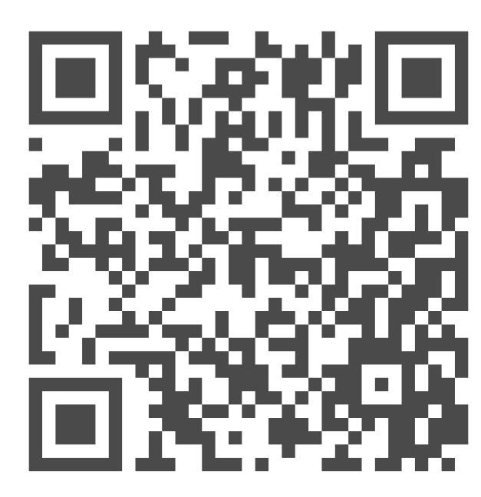

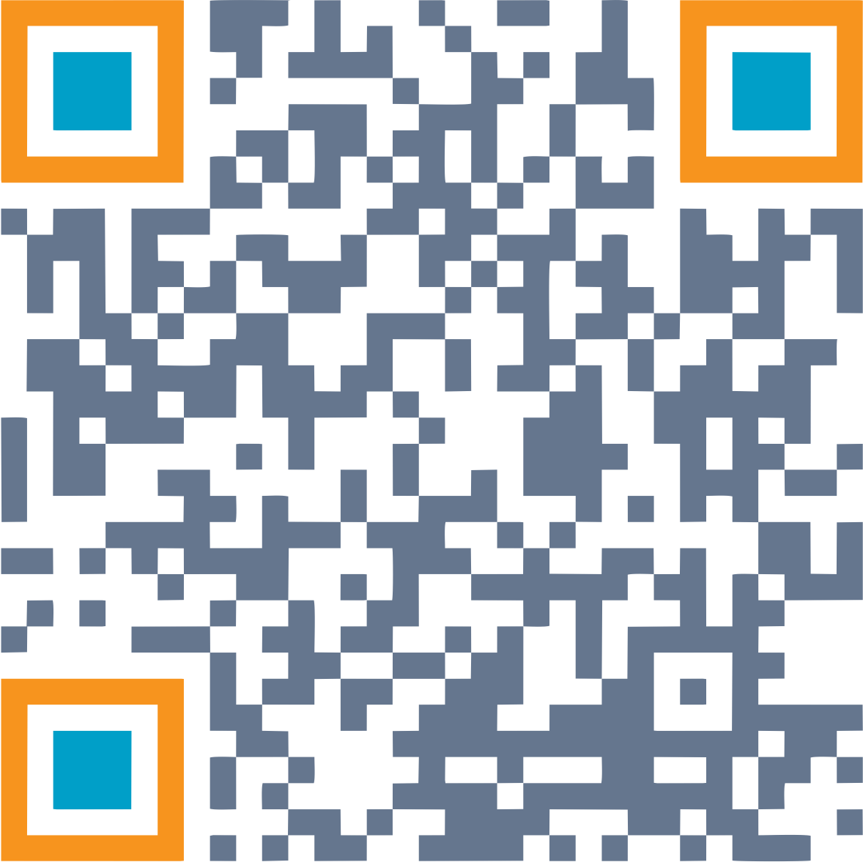
Self care journals
Organisational Consultation
Team training
Resources
Monthly webinars

Slide 36
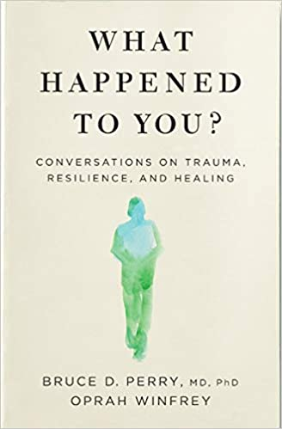



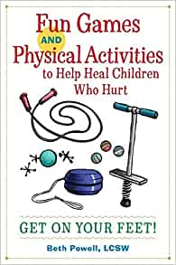
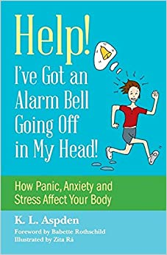
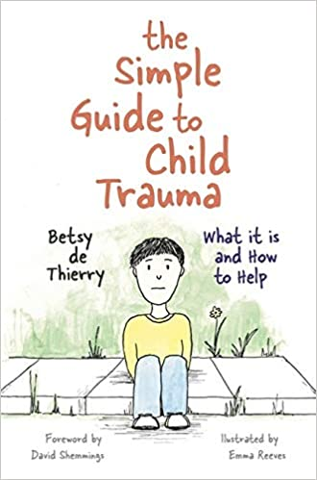
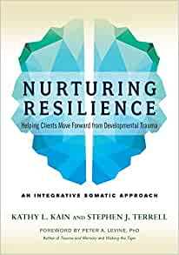
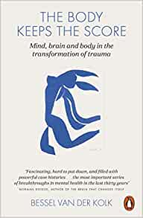

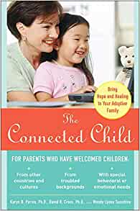
Further reading

Slide 37
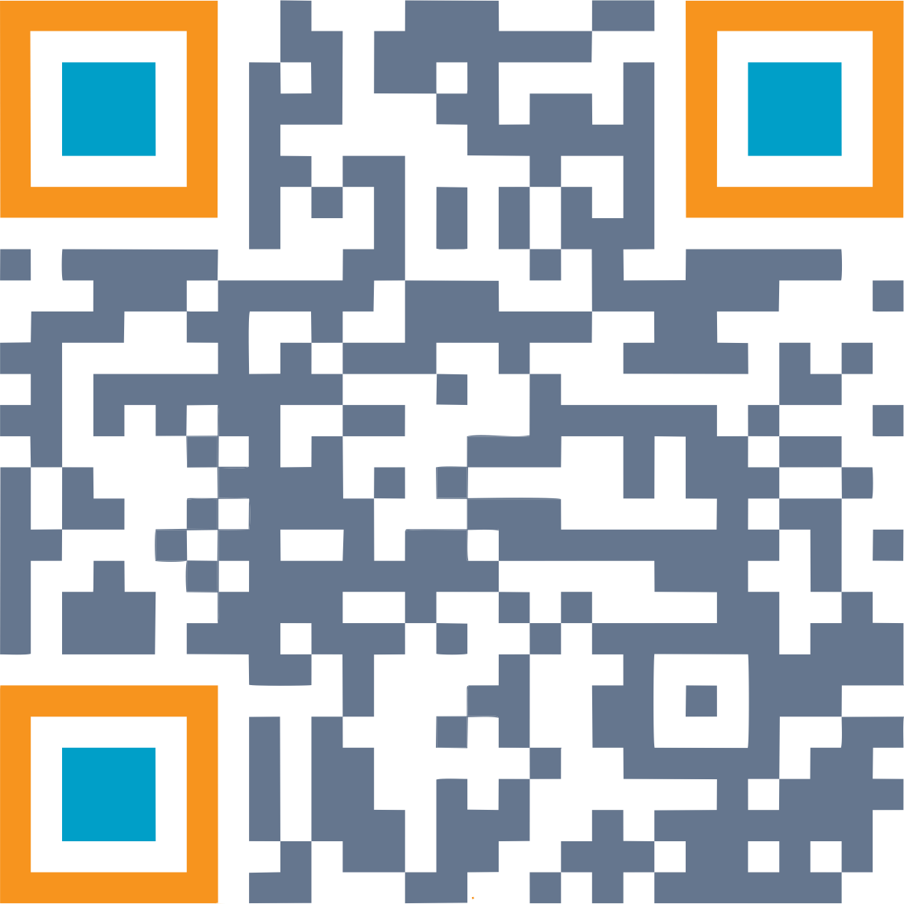
Thank you for coming!
Sign up to receive learning soundbites
& to hear about other trainings at:
www.jointhedots.solutions

