Slide 1
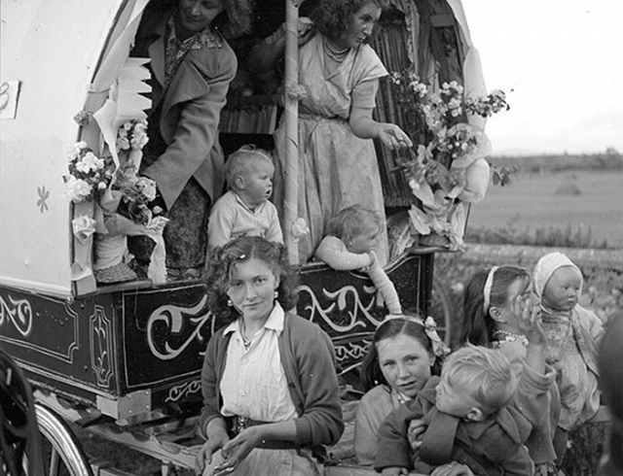

Transcultural Safeguarding
in the Gypsy, Roma &
Traveller Community
Dr. Kathleen Kelly
Consultant Psychiatrist | Volunteer, Centre for Applied Carmelite Spirituality (CACS)
HSCL University of Oxford; Lecturer in Psychospiritual Care, Oxford Brookes University;
Safeguarding Team at CACS. Kathleen.kelly@oxfordhealth.nhs.uk
www.carmelite.uk.net

Slide 2
Objectives of Case Study
Intercultural focus in Gypsy, Roma, Traveller community
Psycho-spiritual approach to trauma
Understand formation needs for those undertaking trauma-informed work
KEYWORDS
Interculturality, identity, presence, trauma, safeguarding, Traveller community
www.carmelite.uk.net

Slide 3
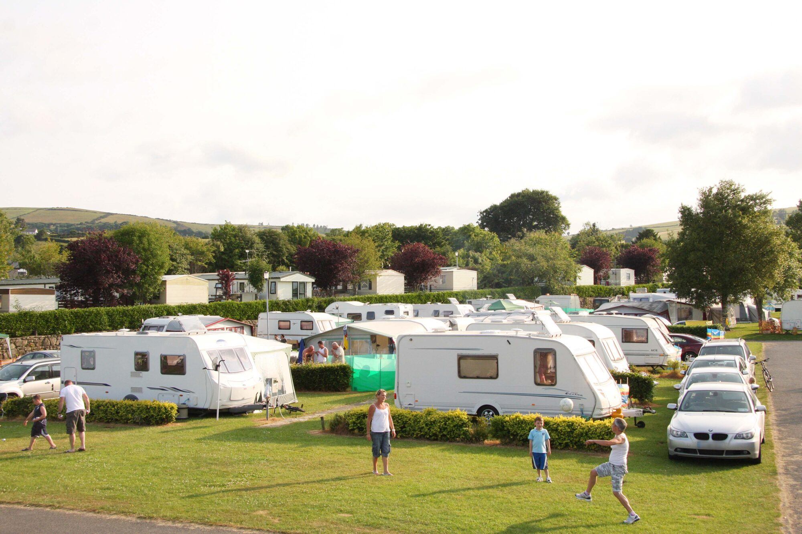
Who are the Traveller Community?
English Gypsies
Romany, Scottish, Welsh populations
Irish Travellers
Distinct Irish heritage & culture
Roma
Recent migrants from Central & Eastern Europe
Other Nomadic Groups
"A diverse range of ethnic groups
and individuals with nomadic lifestyles"
Those with a nomadic way of life
www.carmelite.uk.net

Slide 4
GRT Community: UK Population Statistics
2011 Census Data — Estimated 56,000 GRT individuals in the UK
of Traveller community women are lone parents
vs only 8% in the general population
20%
www.carmelite.uk.net

Slide 5
How Many GRT People Are There Really?
5×
Academic estimates can be
up to 5× higher than the
official Census figure
Sources: 2011 England & Wales Census; Friends, Families & Travellers; Gypsy Traveller Accommodation Needs Assessments
www.carmelite.uk.net

Slide 6
A History of Transgenerational Trauma
Roma Holocaust
Atlantic Slave Trade
Mass persecution and genocide of Romani people across Europe
Traveller community individuals subjected to forced enslavement
1940s–1980s Scotland
Recent Decades
"Tinker Experiment" – enforced hut living and children removed into state care
Repeated failures of state intervention compounding systemic mistrust
www.carmelite.uk.net

Slide 7
Health Inequalities & Barriers to Care Parry et al., 2007
Mental Health Stigma
⚕
Often viewed as shameful or attributed to divine punishment within community
Domestic Abuse Services
🏠
Services frequently not adapted for Traveller community women's cultural needs
GMC Guidance
📋
Doctors regulated to address patients' holistic and spiritual needs
www.carmelite.uk.net

Slide 8
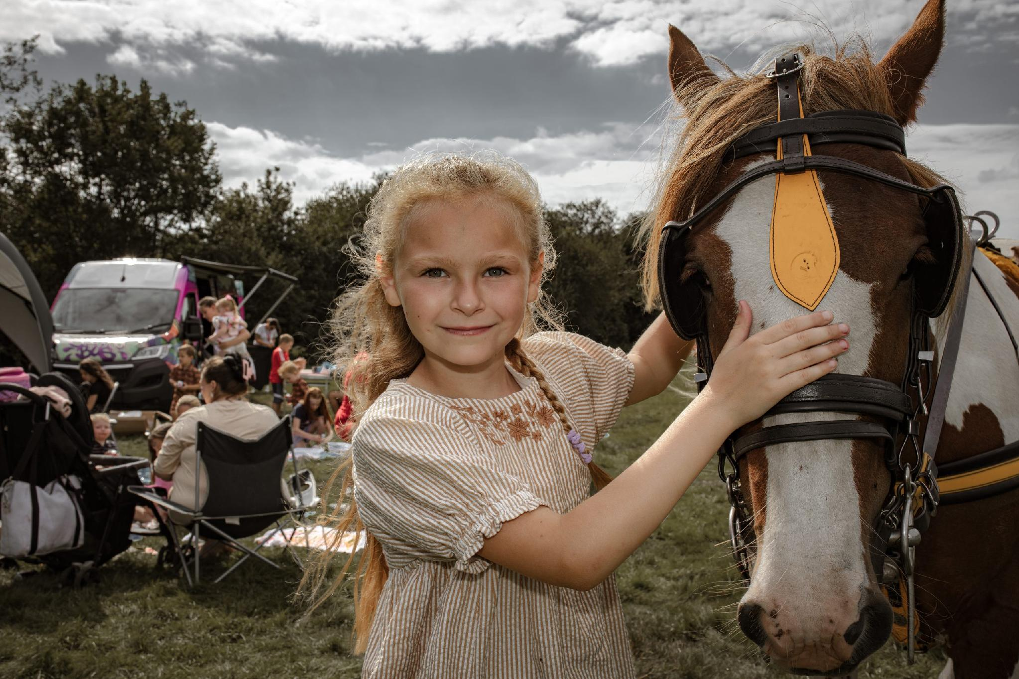
The Clinical Case
Presentation
Middle-aged Traveller woman – severe crisis and fear in the Emergency Department
Background
Long trauma history; previously left community; safe house placement with young children
Current
Homeless; lost contact with her children; sharing flat with elderly man
Challenge
Highly distressed; not responding to standard psychiatric treatment or secular language
Key Issue
Profound mistrust of authority; existing domestic abuse, services not adapted for Traveller community
www.carmelite.uk.net

Slide 9
The Spiritual Approach: What Made the Difference
1
2
3
4
Contemplative Presence
Cultural Discernment
Amplifying Her Voice
Sacred Objects
Deep listening and silent presence – not standard psychiatric assessment
Recognising spiritual dimension as paramount for GRT identity
Engaging hospital chaplaincy to bridge clinical & spiritual care
Rosary beads used for self-regulation, comfort and calm
"All must be friends, all must be held dear,
all must be loved and all must be helped."
OUTCOME
Safe discharge achieved through integrated spiritual & clinical collaboration
– St. Teresa of Ávila | Carmelite Spirituality
www.carmelite.uk.net

Slide 10
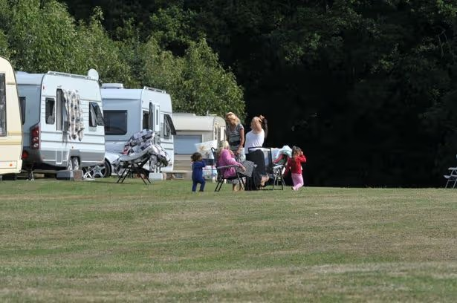
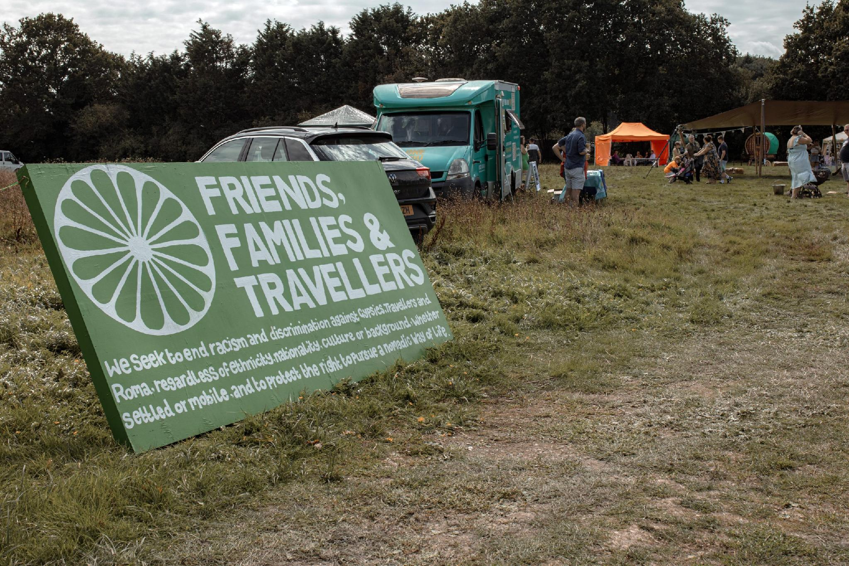
Community Life, Culture & Resilience
A community of deep cultural heritage, faith, family bonds and resilience
Faith & Spirituality
Family Networks
Nomadic Heritage
Deep Catholic faith woven into daily life; religious beliefs central to identity and coping
Strong extended family bonds; community is primary source of support, trust and identity
A way of life misunderstood by mainstream services; dignity in cultural difference must be honoured
www.carmelite.uk.net

Slide 11
Key Implications for Practice
BIOLOGICAL
PSYCHOLOGICAL
› Medication for acute stabilisation
› Trauma-informed assessment
› Physical health screening
› Deep listening over diagnosis
› Safe housing and nutrition needs
› Avoid re-traumatisation by authority
SOCIAL
SPIRITUAL
› Community links
› Recognise religious identity as central
› DA services adapted for GRT women
› Engage chaplaincy, Sacred objects
› Safeguarding with cultural competence
› Carmelite presence: friendship, love, care
www.carmelite.uk.net

Slide 12
Conclusion &
Reflection
Traveller communities carry profound collective transgenerational trauma, requiring culturally sensitive care
Spiritual ministry is not separate from clinical care – it is holistic care
Formation and ongoing adult education equip ministers to safeguard dignity
Contemplative presence, deep listening and friendship are the tools of transformation
UK safeguarding is moving toward openness, partnership and survivor-centred approaches
Centre for Applied Carmelite Spirituality | www.carmelite.uk.net

Slide 13
THANKS FOR YOUR TIME
Dr. Kathleen Kelly
Consultant Psychiatrist | Volunteer, Centre for Applied Carmelite Spirituality (CACS)
www.carmelite.uk.net

